Slide 1

Resource Reservation Protocol
Naman Choudhary
PES2UG20CS209
D section

Slide 2
Introduction :
The Resource Reservation Protocol (RSVP) is a transport layer protocol designed to reserve resources across a network using the integrated services model. RSVP operates over an IPv4 or IPv6 and provides receiver-initiated setup of resource reservations for multicast or unicast data flows.
It does not transport application data but is similar to a control protocol, like Internet Control Message Protocol (ICMP) or Internet Group Management Protocol (IGMP). RSVP is described in RFC 2205

Slide 3
Purpose of Protocol :
RSVP can be used by hosts and routers to request or deliver specific levels of quality of service (QoS) for application data streams. RSVP defines how applications place reservations and how they can relinquish the reserved resources once no longer required.
RSVP operations will generally result in resources being reserved in each node along a path. RSVP is not a routing protocol but was designed to interoperate with current and future routing protocols.

Slide 4
RSVP Architecture
RSVP is a receiver oriented signaling protocol. The receiver initiates and maintains resource reservation.
It is used both for unicasting (sending data from one source to one destination) and multicasting (sending data simultaneously to a group of destination computers).
RSVP supports dynamic automatic adaptation to changes in network.
It provides a number of reservation styles. It also provides support for addition of future styles.

Slide 5
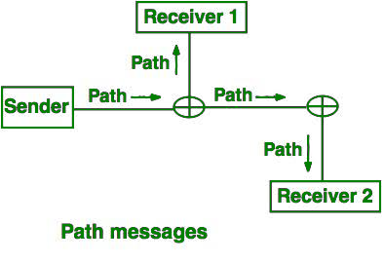
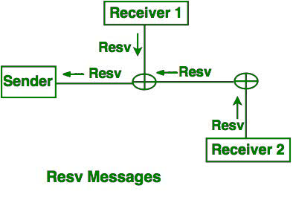
Use OF Protocol :
Path Messages (path): A path message is sent by the sender to all receivers by multicasting storing the path state at each node in its path. It stores the necessary information so that the receivers can make the reservation.
Reservation messages (resv): The resv message is sent by the receiver to the sender along the reverse path of the path message. It identifies the resources that is requires by the data flow.

Slide 6
Conclusion :
An RSVP host that needs to send a data flow with specific QoS will transmit an RSVP path message every 30 seconds that will travel along the unicast or multicast routes pre-established by the working routing protocol. If the path message arrives at a router that does not understand RSVP, that router forwards the message without interpreting the contents of the message and will not reserve resources for the flow.

